Slide 1
Image Processing
Intensity Transformation and spatial filters
1

Slide 2
Image Enhancement?
Enhancement : is to process an image
so that the result is more suitable than the original image for a specific application.
Enhancement techniques are so varied, and use so many different image processing approaches
The idea behind enhancement techniques is to bring out details that are hidden, or simple to highlight certain features of interest in an image.
2

Slide 3
Image Enhancement?
If we used 256 intensities of grayscale then:
In dark image the most of pixels value <128
In bright image the most of pixels value>128 Let x:old image
S:new image
S=x+c where c is constant value
>> S=imadd(x,50); -----------------brighter image S=x-c where c is constant value
>> S=imsubtract(x,50); -------------darker image
We can add 2 image :
H_{y}anan₂Har_{i}d_{m}an
S=x+y (where x and age have same size)³

Slide 4
Image Enhancement Methods
Spatial Domain Methods (Image Plane) Techniques are based on direct manipulation of pixels in an image
Frequency Domain Methods
Techniques are based on modifying the Fourier
transform of the image.
Combination Methods
There are some enhancement techniques based on various combinations of methods from the first two categories
4

Slide 5
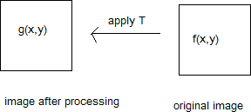
Spatial domain
Spatial domain processes:
1. intensity transformation(Point operation)
- g depends only on the value of f at(x,y)
1. spatial filter (or mask ,kernel, template or window)
5

Slide 6
Intensity (Gray-level)transformations functions
Here, T is called intensity transformation function or (mapping, gray level function)
g(x,y) = T[f(x,y)]
s r
s= T(r)
s,r : denote the intensity of g and f at any point (x,y) . In addition, T can operate on a set of input images
6

Slide 7
Intensity transformations functions
Intensity transformation functions fall into 2 approaches:
Basic intensity transformations
Linear Functions:
Negative Transformation
Identity Transformation
Logarithmic Functions:
Log Transformation
Inverse-log Transformation
Power-Law Functions:
n^{th} power transformation
n^{th} root transformation
7

Slide 8
Intensity transformations functions
piecewise Linear transformation functions.
Contrast stretching, thresholding
Gray-level slicing
Bit-plane slicing
8

Slide 9
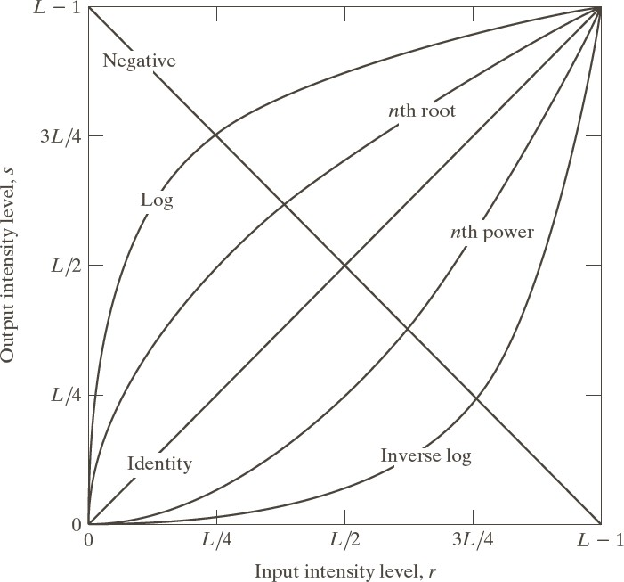
Basic intensity transformations
Linear ( negative and identity).
logarithmic ( Log and Inverse Log) .
Power( nth power and nth roo
ليدعتلا دعب ةروصلاب gray levels ةينوللا تاجردتلا 256 كانه نوكيس 8 bit لسكبلا يف ناك نا ,لاثمف
)L=256( جردت
t).
9

Slide 10
Identity Function
Output intensities are identical to input intensities
This function doesn’t have an effect on an image, it was included in the graph only for completeness
Its expression:
s = r

Slide 11
Image Negatives (Negative Transformation)
The negative of an image with gray level in the range [0, L-1], where L = Largest value in an image, is obtained by using the negative transformation’s expression:
s = L – 1 – r
Which reverses the intensity levels of an input image , in this manner produces the equivalent of a photographic negative.
The negative transformation is suitable for enhancing white or gray detail embedded in dark regions of an image, especially when the black area are dominant in size

Slide 12
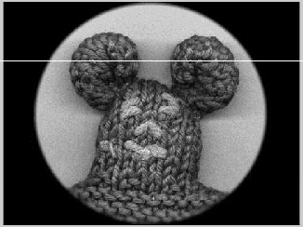
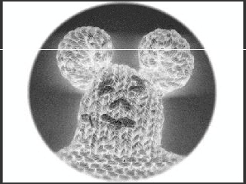
Image Negatives (Negative Transformation)
Output gray level
s = L – 1 – r
Input gray level

Slide 13
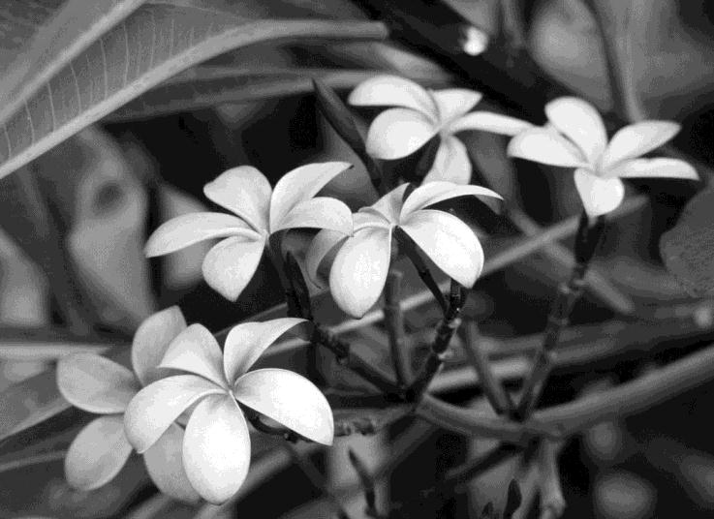
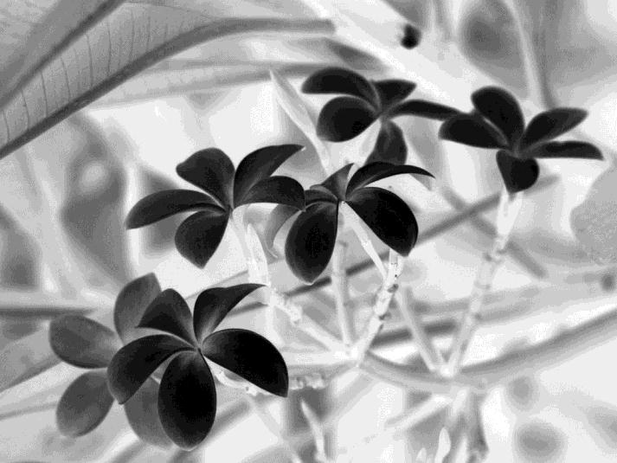
Image Negatives (Negative Transformation)
Image (r(
Image (s ( after applying T (negative)
Advantages of negative :
Produces an equivalent of a photographic negative.
Enhances white or gray detail embedded in dark regions.

Slide 14
Image Negatives (Negative Transformation)
Note how much clearer the tissue is in the negative image

Slide 15
Image Negatives (Negative Transformation)
Example 1:
the following matrix represents the pixels values of an 8-bit image (r) , apply negative transform and find the resulting image pixel values.
Image (r)
solution:
L= 2⁸ = 256
s=L-1-r s =255-r
100 | 110 | 90 | 95
98 | 140 | 145 | 135
89 | 90 | 88 | 85
102 | 105 | 99 | 115
Apply this transform to
each pixel to find the negative
Image (s)
155 | 145 | 165 | 160
157 | 115 | 110 | 120
166 | 165 | 167 | 170
153 | 150 | 156 15 | 140

Slide 16
Image Negatives (Negative Transformation)
Exercise:
the following matrix represents the pixels values of a 5-bit image (r) , apply negative transform and find the resulting image pixel values.
Image (r)
21 | 26 | 29 | 30
19 | 21 | 20 | 30
16 | 16 | 26 | 31
19 | 18 | 27 | 23
solution:
Image (s)

Slide 17
Image Negatives (Negative Transformation)
The negative of an image can be obtained also with IPT
function imcomplement:
g = imcomplement (f);

Slide 18
Log Transformations function
The general form of the log transformation:
s = c log (1+r)
Where c is a constant, and r ≥ 0
Log curve maps a narrow range of low gray-level values in the input image into a wider range of the output levels.
Used to expand the values of dark pixels in an image while compressing the higher-level values.
It compresses the dynamic range of images with large variations in pixel values.
Log functions are particularly useful when the input grey level values may have an extremely large range of values

Slide 19
Log Transformations function
Logarithmic transformations are implemented
expression:
g = c * log (1 + double (f))
using the

Slide 20
Log Transformations function
But this function changes the data class of the image to double, so another sentence to return it back to uint8 should be done:
gs = im2uint8 (mat2gray(g));
Use of mat2gray brings the values to the range [0 1] and im2uint8 brings them to the range [0 255]

Slide 21


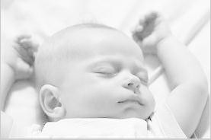
Log Transformations function
Example:
>> g = log(1 + double(f));
>> gs = im2uint8(mat2gray(g));
>> imshow(f), figure, imshow (g), figure, imshow(gs);
f
g
gs

Slide 22
Inverse Logarithm Transformation
Do opposite to the log transformations
Used to expand the values of high pixels in an image while compressing the darker-level values.

Slide 23
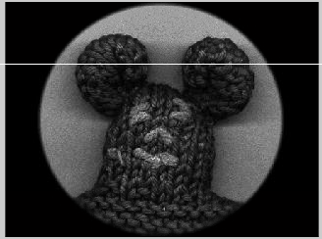
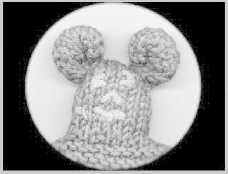
Logarithmic Transformations
InvLog
Log

Slide 24
Power-Law Transformations
Power-law(Gamma) transformations have the basic form of:
s = c.r^{ᵞ}
Where c and ᵞ are positive constants
Map a narrow range of dark input values into a wider range of output values or vice versa

Slide 25
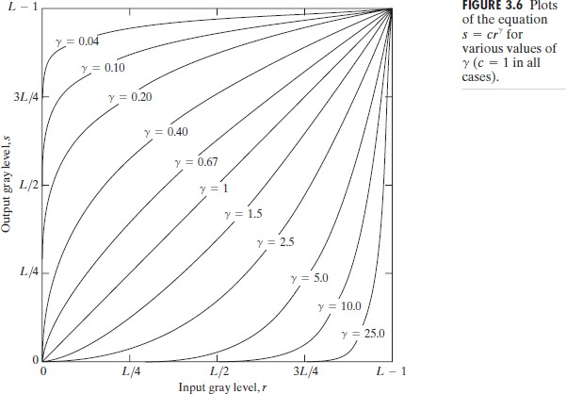
Power-Law Transformations
Different transformation curves are obtained by varying ᵞ (gamma)

Slide 26
Power-Law Transformations
If gamma <1 :the mapping is weighted toward brighter output values.
If gamma =1 (default):the mapping is linear.
If gamma >1 :the mapping is weighted toward darker output values.

Slide 27
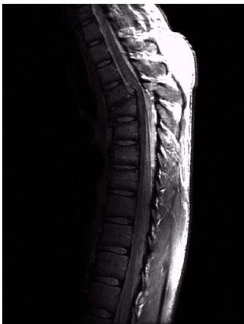
Power Law Example

Slide 28
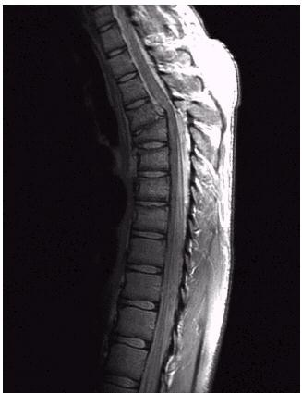
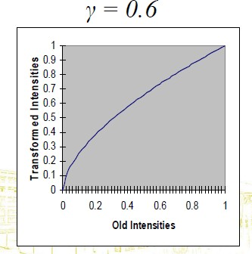
Power Law Example

Slide 29
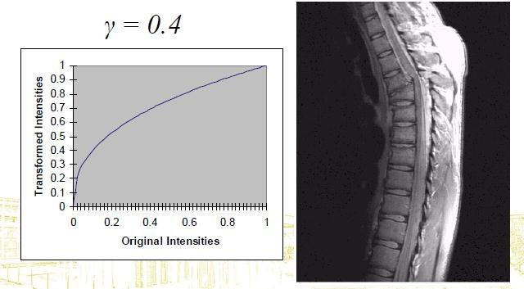
Power Law Example

Slide 30
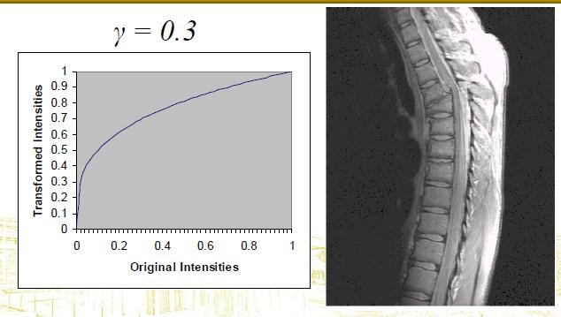
Power Law Example

Slide 31
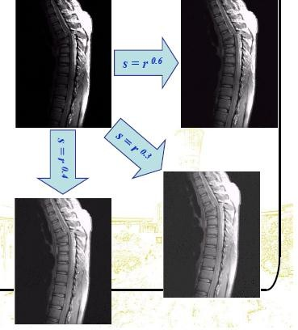
Power Law Example
•The images to the right
show a magnetic resonance
(MR) image of a fractured human spine
•Different curves highlight
different detail

Slide 32
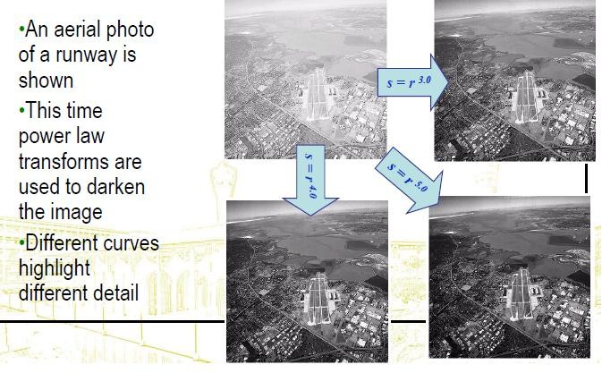
Power Law Example

Slide 33
Function imadjust
Function imadjust is the basic IPT tool for intensity transformations of gray-scale images. It has the syntax:
g = imadjust (f, [low_in high_in], [low_out high_out], gamma)

Slide 34
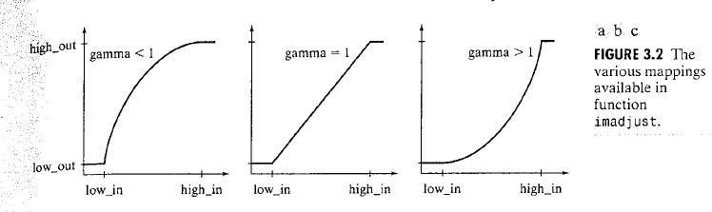
Function imadjust
As illustrated in figure 3.2 (above), this function maps the intensity values in image f to new values in g, such that values between low_in and high_in map to values between low_out and high_out.
Values below low_in and above high_in are clipped; that is values below low_in map to low_out, and those above high_in map to high_out.

Slide 35
Function imadjust
The input image can be of class uint8, uint16, or double, and the output image has the same class as the input.
All inputs to function imadjust, other than f, are specified as values between 0 and 1, regardless of the class of f. If f is of class uint8, imadjust multiplies the value supplied by 255 to determine the actual values to use; if f is of class uint16, the values are multiplied by 65535.
Using the empty matrix ([ ]) for [low_in high_in] of for [low_out high_out] results in the default values [0 1].
If high_out is less than low_out, the output intensity is reversed.

Slide 36
Function imadjust
Parameter gamma specifies the shape of the curve that maps the intensity values of f to create g. If gamma is less than 1, the mapping is weighted toward higher (brighter) output values, as fig 3.2 (a) shows. If gamma is greater than 1, the mapping is weighted toward lower (darker) output values. If it is omitted from the function arguments, gamma defaults to 1 (linear mapping).

Slide 37
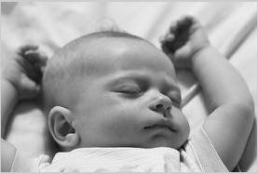
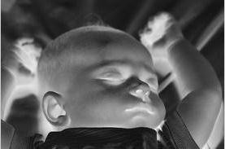
Function imadjust
Example1:
>> f = imread ('baby-BW.jpg');
>> g = imadjust (f, [0 1], [1 0]);
>> imshow(f), figure, imshow (g);
>> imshow(f), figure, imshow (g);
This Obtaining the negative image
f
g
37

Slide 38
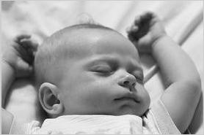
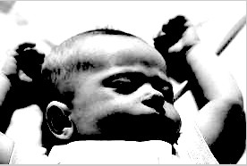
Function imadjust
Example2:
>> g = imadjust (f, [0.5 0.75], [0 1], .5);
>> imshow(f), figure, imshow (g);
f
g

Slide 39
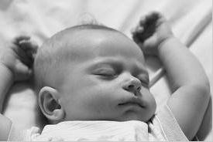

Function imadjust
Example3:
>> g = imadjust (f, [0.5 0.75], [0.6 1], 0.5);
>> imshow(f), figure, imshow (g);
f
g

Slide 40
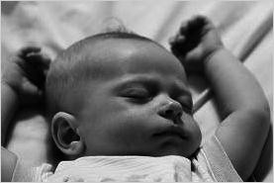
Function imadjust
Example4:
>> g = imadjust (f, [ ], [ ], 2);
>> imshow(f), figure, imshow (g);
f
g

Slide 41
Piecewise-Linear Transformation Functions
Principle Advantage: Some important transformations can be formulated only as a piecewise function.
Principle Disadvantage: Their specification requires more user input that previous transformations
Types of Piecewise transformations are:
Contrast Stretching
Gray-level Slicing
Bit-plane slicing

Slide 42
Contrast Stretching
One of the simplest piecewise linear functions is a contrast-stretching transformation, which is used to enhance the low contrast images.
Low contrast images may result from:
Poor illumination
Wrong setting of lens aperture during image acquisition.

Slide 43
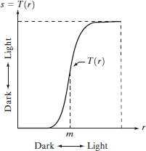
Contrast Stretching
If T(r) has the form as shown in the figure below, the effect of applying the transformation to every pixel of f to generate the corresponding pixels in g would:
Produce higher contrast than the original
image, by:
Darkening the levels below m in the original image
Brightening the levels above m in the original image
So, Contrast Stretching: is a simple image
enhancement technique that improves the contrast in an image by ‘stretching’ the range of intensity values it contain^{H}s^{ana}t^{n} o^{Hard}s^{an}pan a desired range of values.
43

Slide 44
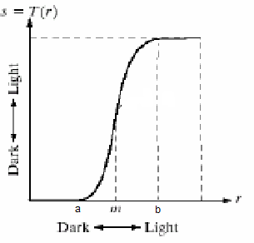
Contrast Stretching
(r2, s2)
(r1, s1)
Contrast stretching
Assume that a: rmin, b:rmax,
Contrast stretching:
(r1,s1)=(rmin,0) , (r2,s2)=(rmax,L-1)
44

Slide 45

Contrast Stretching
 Remember that:
Example: in the graph, suppose we have the
g(x,y) = T[f(x,y)]
Or
s= T(r)
following intensities : a=90, b=180, m=100
if r is above 180 ,it becomes 255 in s.
If r is below 90 , it becomes 0,
If r is between 90, 180 , T applies as follows:
when r < 100 , s closes برتقتto zero (darker) when r>100 , s closes to 255 (brighter)
Pixels above 180 become 255
255
brighter
If r >180; s =255
If r <180 and r<90; s=T(r)
If r <90; s =0
T=
darker
This is called contrast stretching, which means that the bright pixels in the image will become brighter
0
255
and the dark pixels will become darker, this means :
hig^{H}h^{an}eªr^{n H}cªo^{r}n^{da}t^{n}rast image.
45
Pixels less than 90 become 0

Slide 46

Contrast-Stretching Transformation
The function takes the form of:
Where r represents the intensities of the input image, s the corresponding intensity values in the output image, and E controls the slope of the function.
46

Slide 47


Contrast Stretching
Image (s ( after applying T
(contrast stretching)
Image (r(
Notice that the intensity transformation function T, made the pixels with dark intensities darker and the bright ones even more brighter, this is called
contrast stretching>
47

Slide 48
Contrast-Stretching Transformation
This equation is implemented in MATLAB for the entire image as
Note the use of eps to prevent overflow if f has any 0 values.

Slide 49

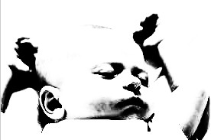
Contrast-Stretching Transformation
Example1:
>>g = 1 ./ (1+ (100 ./(double(f) + eps)) .^ 20);
>> imshow(f), figure, imshow(g);

Slide 50
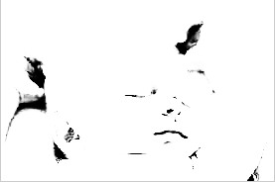
Contrast-Stretching Transformation
Example2:
>> g = 1 ./ (1+ (50 ./(double(f) + eps)) .^ 20);
>> imshow(f), figure, imshow(g);

Slide 51
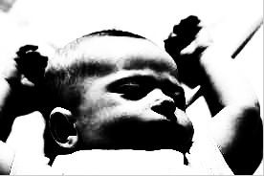
Contrast-Stretching Transformation
Example3:
>> g = 1 ./ (1+ (150 ./(double(f) + eps)) .^ 20);
>> imshow(f), figure, imshow(g);

Slide 52
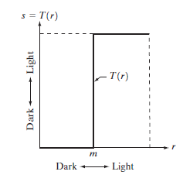
Thresholding
Is a limited case of contrast stretching, it produces a two- level (binary) image.
Some fairly simple, yet powerful, processing approaches can be formulated with grey-level transformations. Because enhancement at any point in an image depends only on the gray level at that point, techniques in this category often are referred to as point processing.

Slide 53
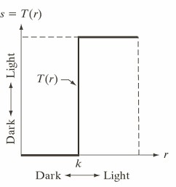
Thresholding
Assume that a: rmin, b:rmax,
k : intensity
(r2, s2)
Contrast stretching: (r1,s1)=(rmin,0) , (r2,s2)=(rmax,L-1) Thresholding:
(r1,s1)=(k,0) , (r2,s2)=(k,L-1)
(r1, s1)
Thresholding:

Slide 54
Thresholding
 Remember that:
g(x,y) = T[f(x,y)]
Or
s= T(r)
Example: suppose m= 150 (called threshold),
if r (or pixel intensity in image f ةيلصلاا ةروصلا ) is above this threshold it becomes 1 in s (or pixel intensity in image g ليدعتلا دعب ةروصلا ), otherwise it becomes zero.
Pixels above 150 become 1
255
If f(x,y)>150; g(x,y)=1
If f(x,y)<150; g(x,y)=0
T=
Or simply…
This is called thresholding, and it produces a binary ima₅g₄e!
T=
If r >150; s =1
0
255
If r <150; s =0
Pixels less than 150 become 0

Slide 55
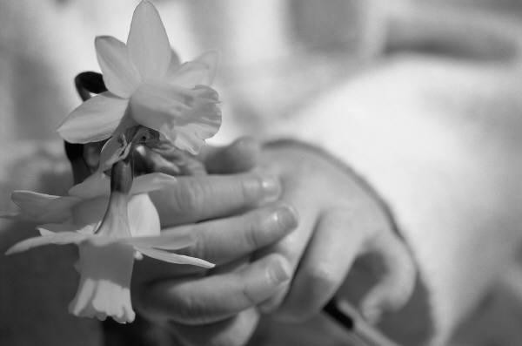

Thresholding
Image (s ( after applying T
(Thresholding)
Image (r (
Notice that the intensity transformation function T, convert the pixels with dark intensities into black and the bright pixels into white. Pixels above threshold is considered bright and below it is
considered dark, and this pr^{H}oªc^{na}e^{n}s^{H}s^{ard}iªs^{n} called thresholding.
55

Slide 56
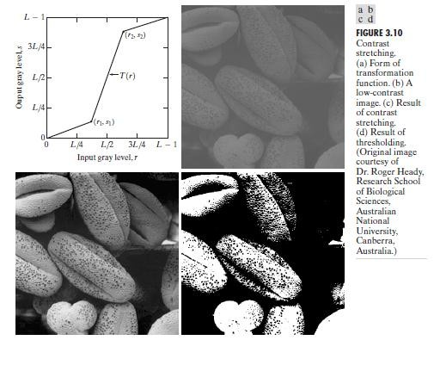
Contrast Stretching
56

Slide 57

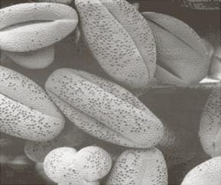
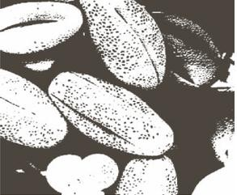
Application on Contrast stretching and thresholding
8-bit image with low contrast
After contrast stretching
(r1,s1)=(r_{min},0) , (r2,s2)=(r_{max},L-1)
Thresholding function (r1,s1)=(m,0) , (r2,s2)=(m,L-1)
m : mean_{H}i_{a}n_{na}t_{n}e_{H}n_{ar}s_{da}it_{n}y level in the image
57

Slide 58
Contrast Stretching
Figure 3.10(a) shows a typical transformation used for contrast stretching. The locations of points (r1, s1) and (r2, s2) control the shape of the transformation function.
If r1 = s1 and r2 = s2, the transformation is a linear function that produces no changes in gray levels.
If r1 = r2, s1 = 0 and s2 = L-1, the transformation becomes a thresholding function that creates a binary image.
Intermediate values of (r1, s1) and (r2, s2) produce various degrees of spread in the gray levels of the output image, thus affecting its contrast.
In general, r1 ≤ r2 and s1 ≤ s2 is assumed, so the function is always increasing.

Slide 59
Contrast Stretching
Figure 3.10(b) shows an 8-bit image with low contrast.
Fig. 3.10(c) shows the result of contrast stretching, obtained by setting (r1, s1) = (r_{min}, 0) and (r2, s2) = (r_{max},L-1) where r_{min} and r_{max} denote the minimum and maximum gray levels in the image, respectively. Thus, the transformation function stretched the levels linearly from their original range to the full range [0, L-1].
Finally, Fig. 3.10(d) shows the result of using the thresholding function defined previously, with r1=r2=m, the mean gray level in the image.

Slide 60
piecewise Linear transformation functions.
Exercise:
the following matrix represents the pixels values of a 8-bit image
(r) , apply thresholding transform assuming that the threshold m=95, find the resulting image pixel values.
Image (r)
solution:
110 | 120 | 90 | 130
91 | 94 | 98 | 200
90 | 91 | 99 | 100
82 | 96 | 85 | 90
Image (s)

